Slide 1
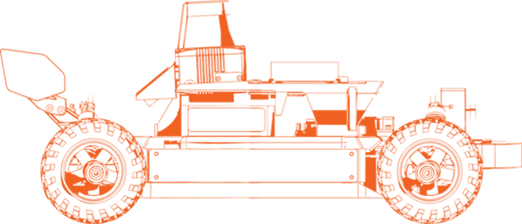
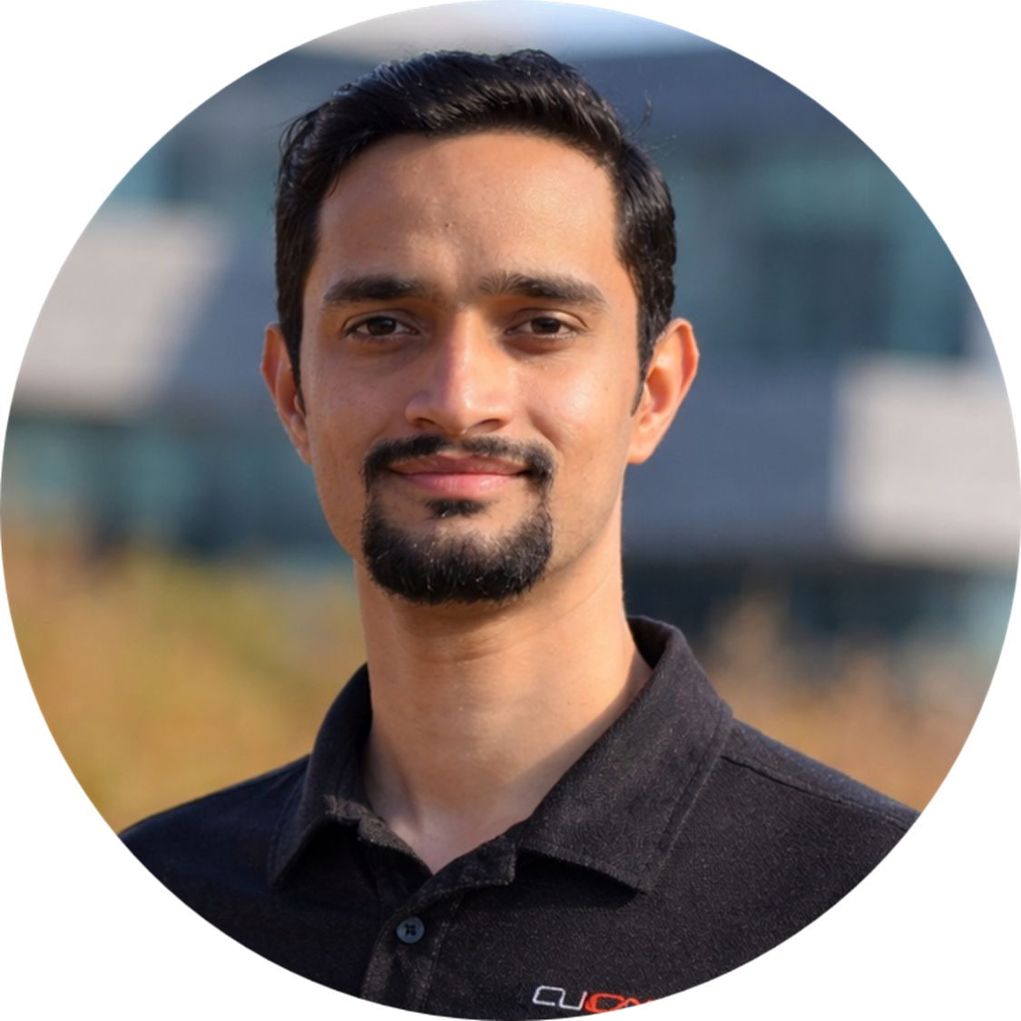
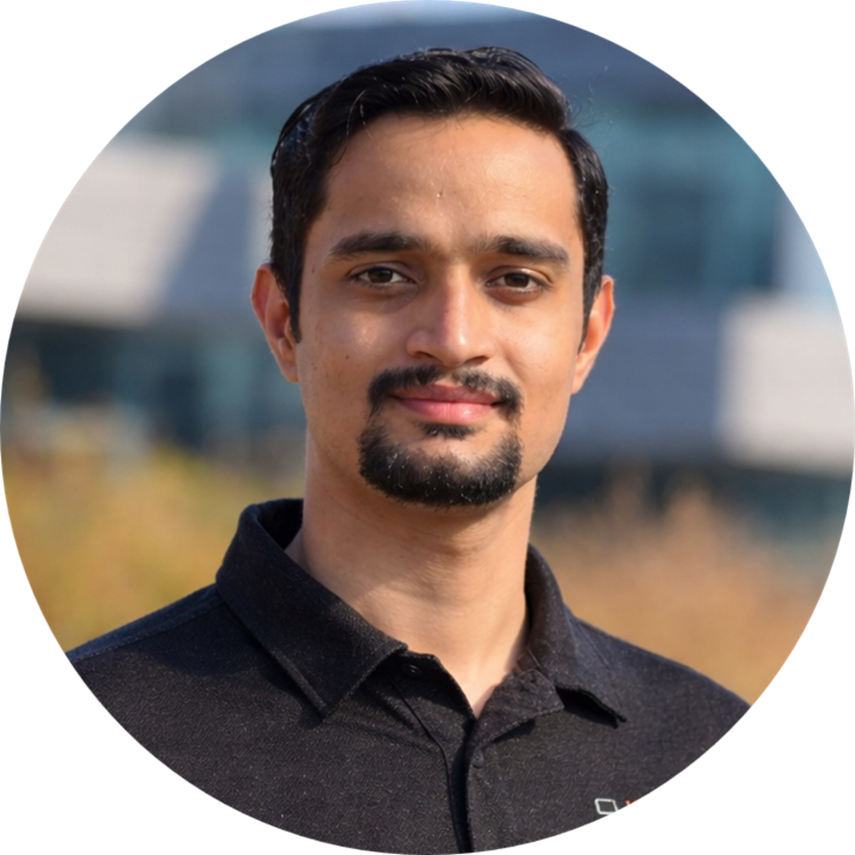
LAB-01
Developer Onramp
Chinmay Vilas Samak
Ph.D. Candidate
ARMLab, CU-ICAR
Email: csamak@clemson.edu
Tanmay Vilas Samak
Ph.D. Candidate
ARMLab, CU-ICAR
Email: tsamak@clemson.edu

Slide 2

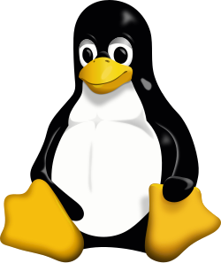
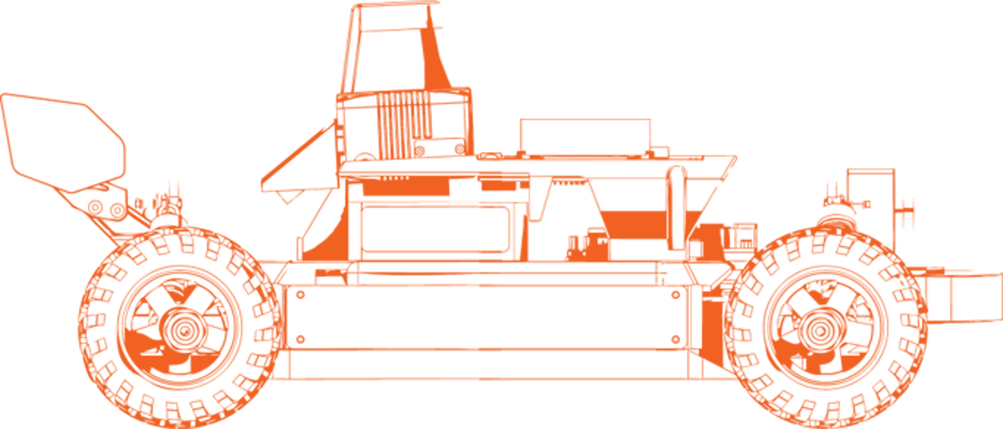

Lab Outline and Expected Outcomes
Development
  Linux (Ubuntu 22.04)
  Windows Subsystem for Linux (WSL 2)
Version Control
  Git
  GitHub
Containerization
  Docker
  Docker Hub
GOAL: Develop, collaborate, package & deploy seamlessly

Slide 3
Linux 101

Slide 4

Meet Linux
Linux makes a developer’s life easy
Meet the terminal
Understand the filesystem
Edit text in the terminal
Manage permissions
Manage packages
Manage processes
Getting help
Terminal
Run commands
and inspect output
Filesystem
Navigate paths
and manage files
System tools
Permissions, packages, and
processes
whoami → pwd → ls
Small commands build a reliable picture of where you are and what is happening.
Linux-101.md

Slide 5
Git 101

Slide 6
Meet Git
Git turns edits into traceable history
Install and configure Git
Create a local repository
Inspect and correct changes
Branches
Connect to GitHub
Everyday collaboration workflow
Resolve a merge conflict
Useful history commands
Working Tree
Edit files
locally
Staging Area
Select the exact next snapshot
Commit
Save a focused
checkpoint
Remote
Share and
collaborate
git add → git commit → git push
Branches let you isolate experiments before merging them into the main line.
Git-101.md

Slide 7
Docker 101

Slide 8
Meet Docker
Docker makes the environment portable
Install and configure Docker
Run containers
Container lifecycle
Images
Bind mounts and volumes
Port mapping
Build an image with a Dockerfile
Connect to Docker Hub
Environment variables
Resource limits
Clean up safely
Dockerfile
Build recipe
Image
Read-only
package
Container
Running
instance
Registry
Share
images
docker build → docker run → docker push
Volumes, bind mounts, ports, and resource limits connect the container to the host safely.
Docker-101.md

Slide 9
Thank You!
Open to questions and discussion…

